Slide 1
Interface Design & Programming
Assignment Report (Reduced Ver.)
Members: Lim Pei Sheng
Nicholas Poh

Slide 2
Task breakdown
Pei Sheng |  | Nicholas
UI task | UI Description | UI task | UI Description
Character Screen | Character Selection, Creation, Deletion | Account Information | Account ID, Registration, Binding
Main Game | Game Roadmap(All the UI placement) | Quest | Main, Repeatable, Event
Character Information | Inventory, Stats, Skills | Shop | Buy, Sell, Repair, Rebuy
World Map Mini Map | World, Dungeon, Town Map | Options | Video, Audio, Configurations
Chat | World, Buddy, Party, Guild Chat | Community | Buddy, Party, Guild

Slide 3
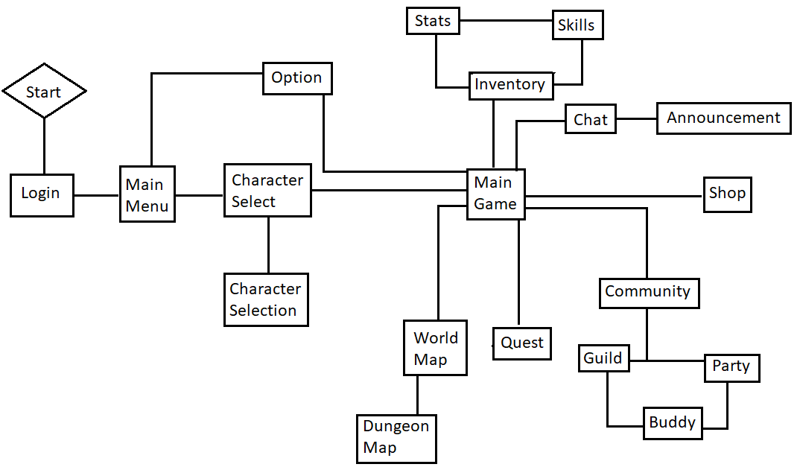
Menu Flowchart

Slide 4
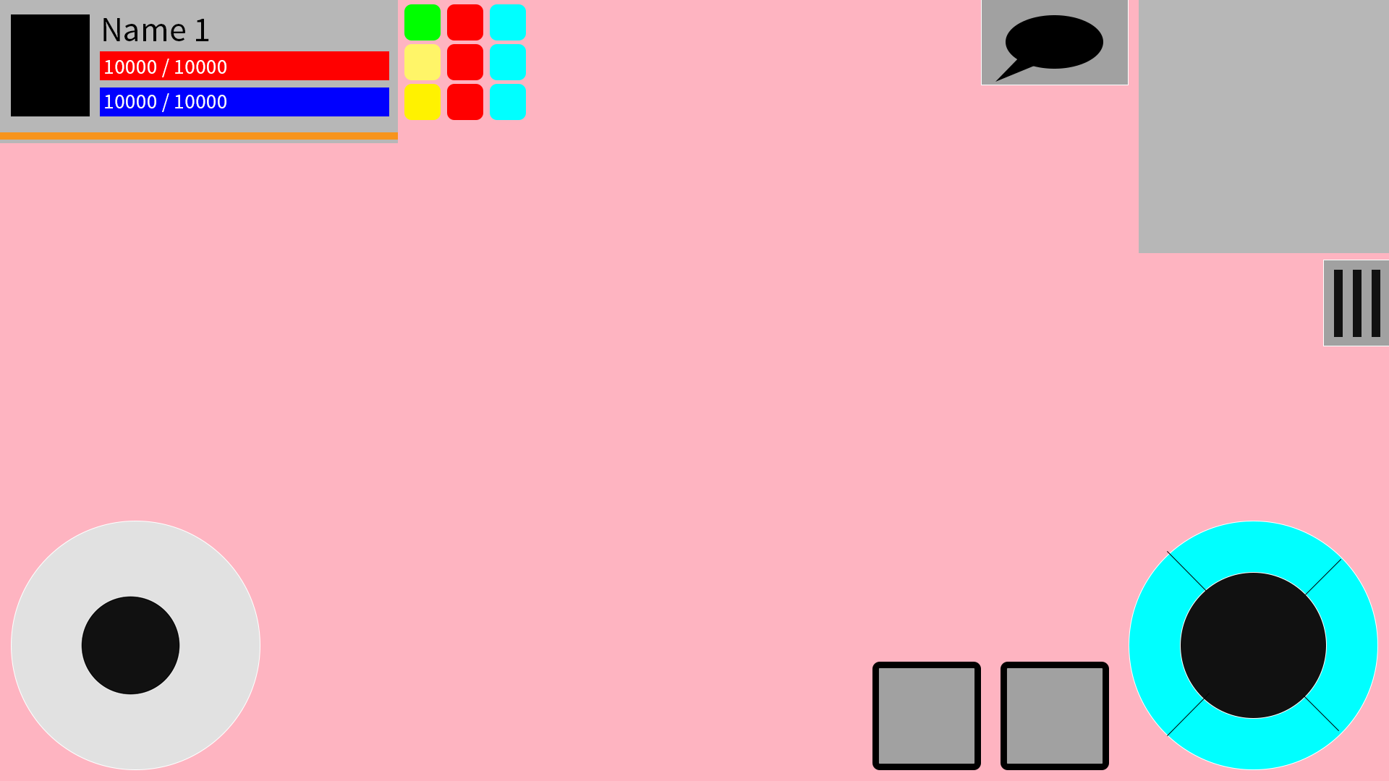
Game Screen
User Interface in the game follows the layout of many other RPG games.
Compact and simple
Accessibles are relative to their purpose;
Mini Map -> World map
Character Info -> Inventory, Stats, Skills
Chat -> Chat overlay & Announcements
Tab -> Menu that are not critical
Chat
Character Info
Mini Map
Tab
Movement Control
Attack & Skills

Slide 5
Skill chain system
Skills can be casted by sliding the attack button where a directional skill overlay will appear as opposed to clicking the skills. Players can choose to change to ‘Click to Cast’ feature.
Skill chains can also be triggered by swapping the current used skills to the next.
Skill 2
Skill 1
Skill 3

Slide 6
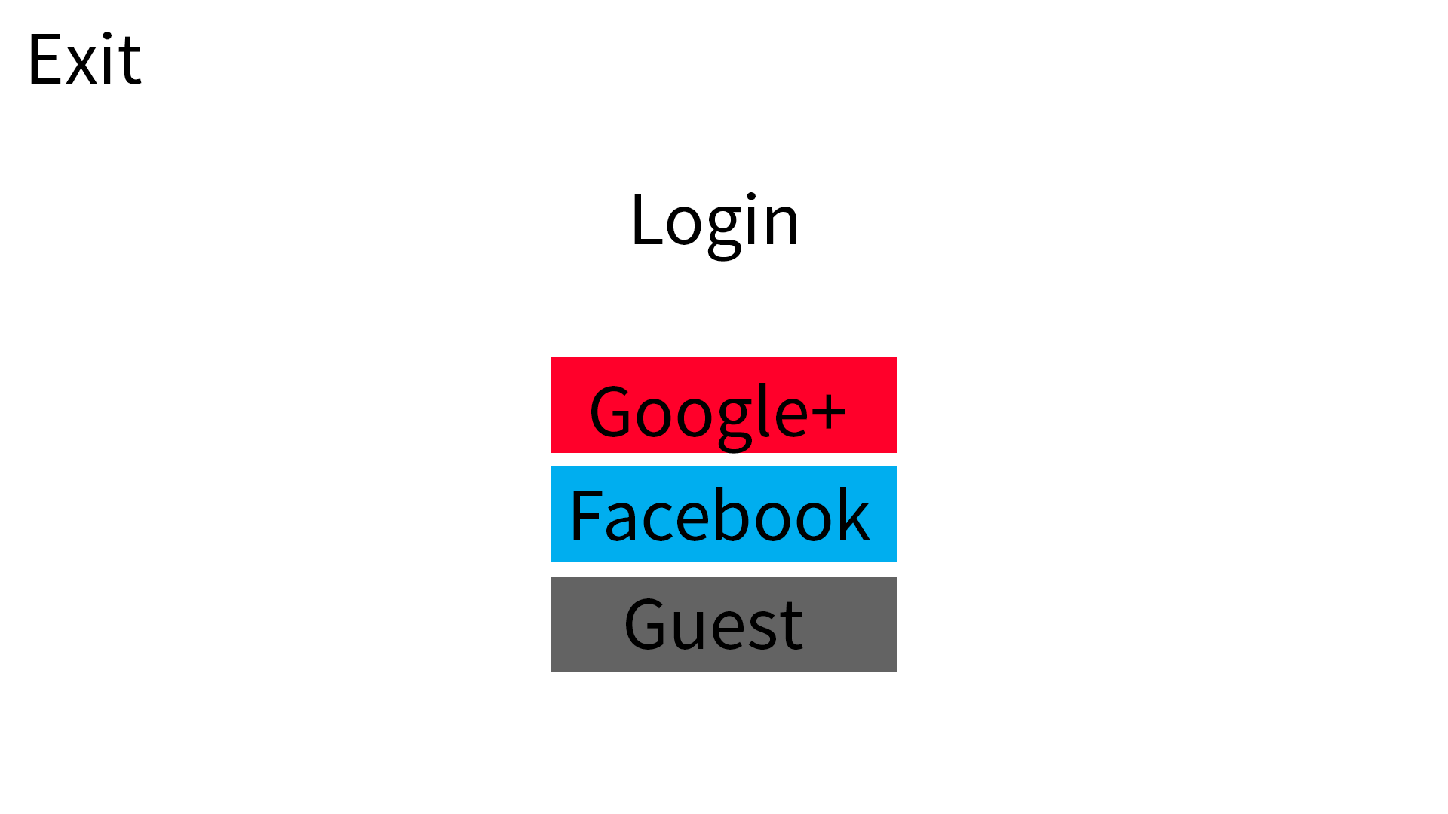

Slide 7
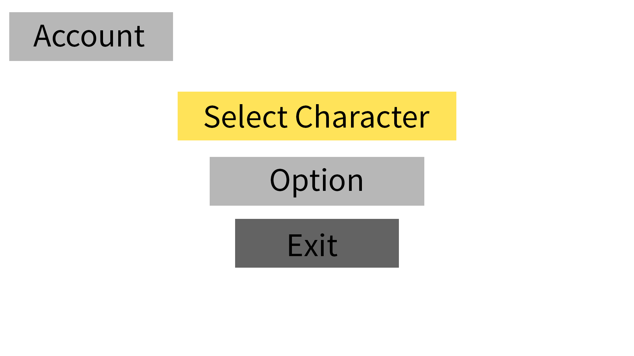

Slide 8
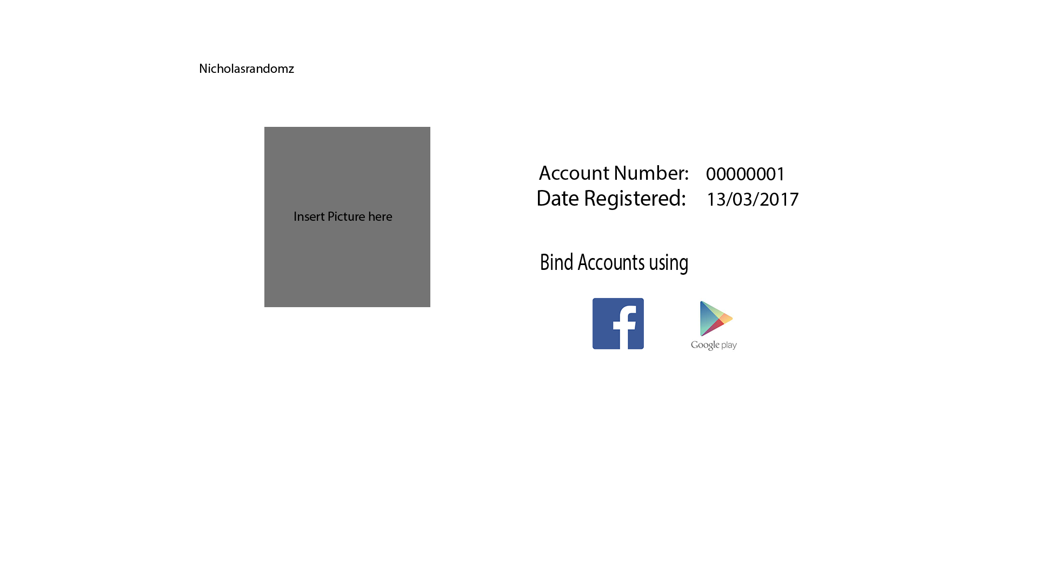

Slide 9
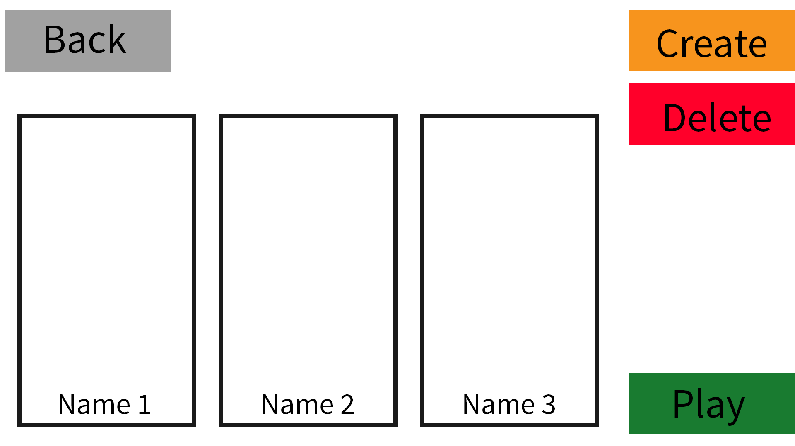

Slide 10
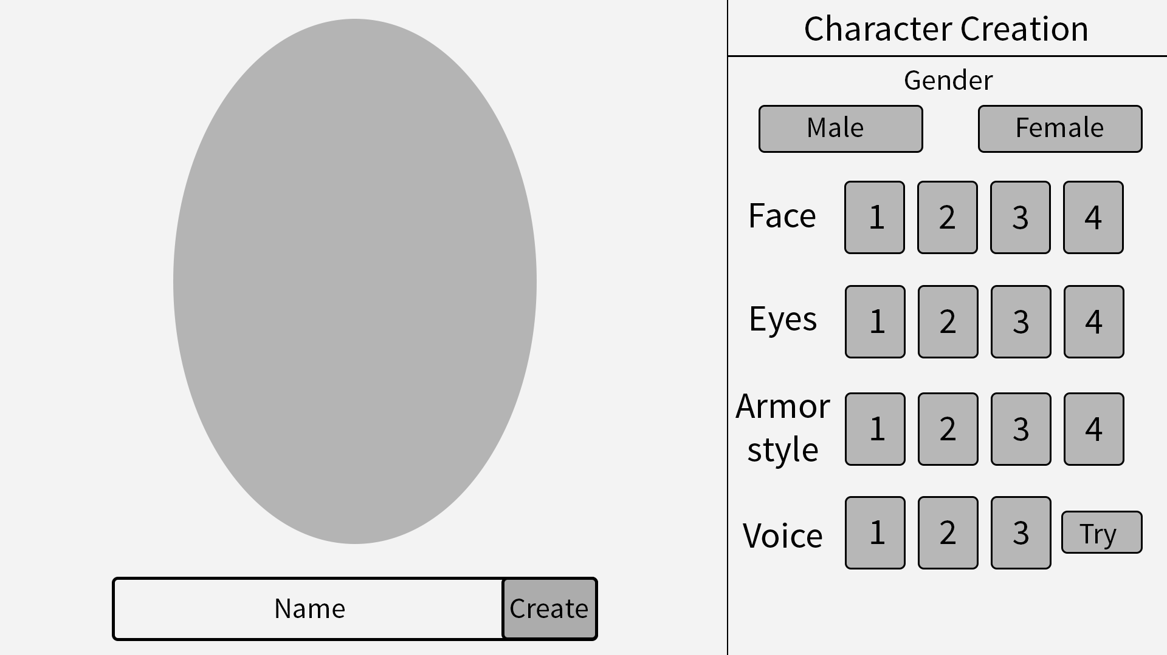
CHARACTER CREATION NOT DONE ASJDBASKHDSAHDLKSADLKASJDA
Back

Slide 12
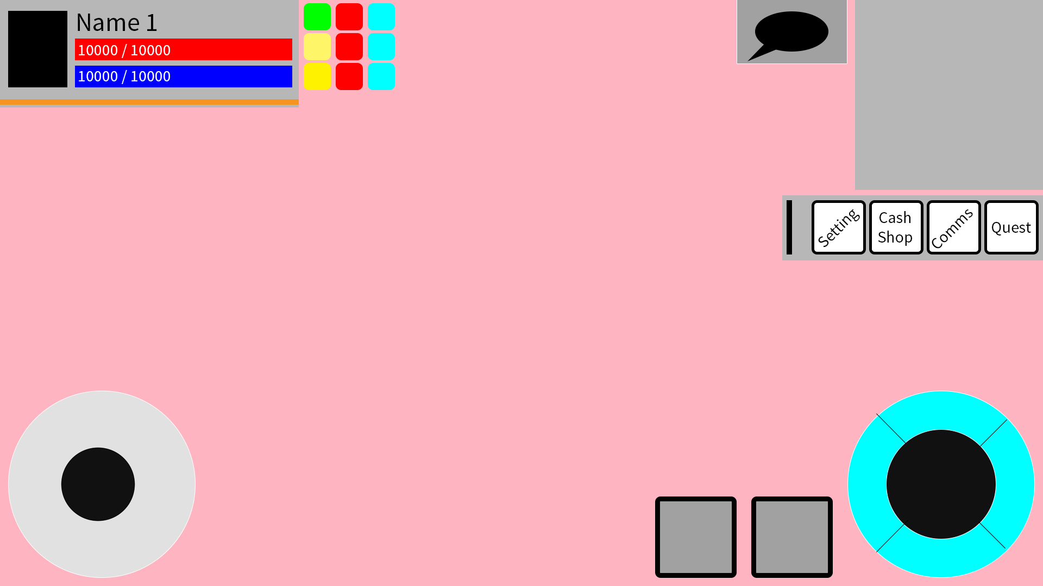

Slide 13
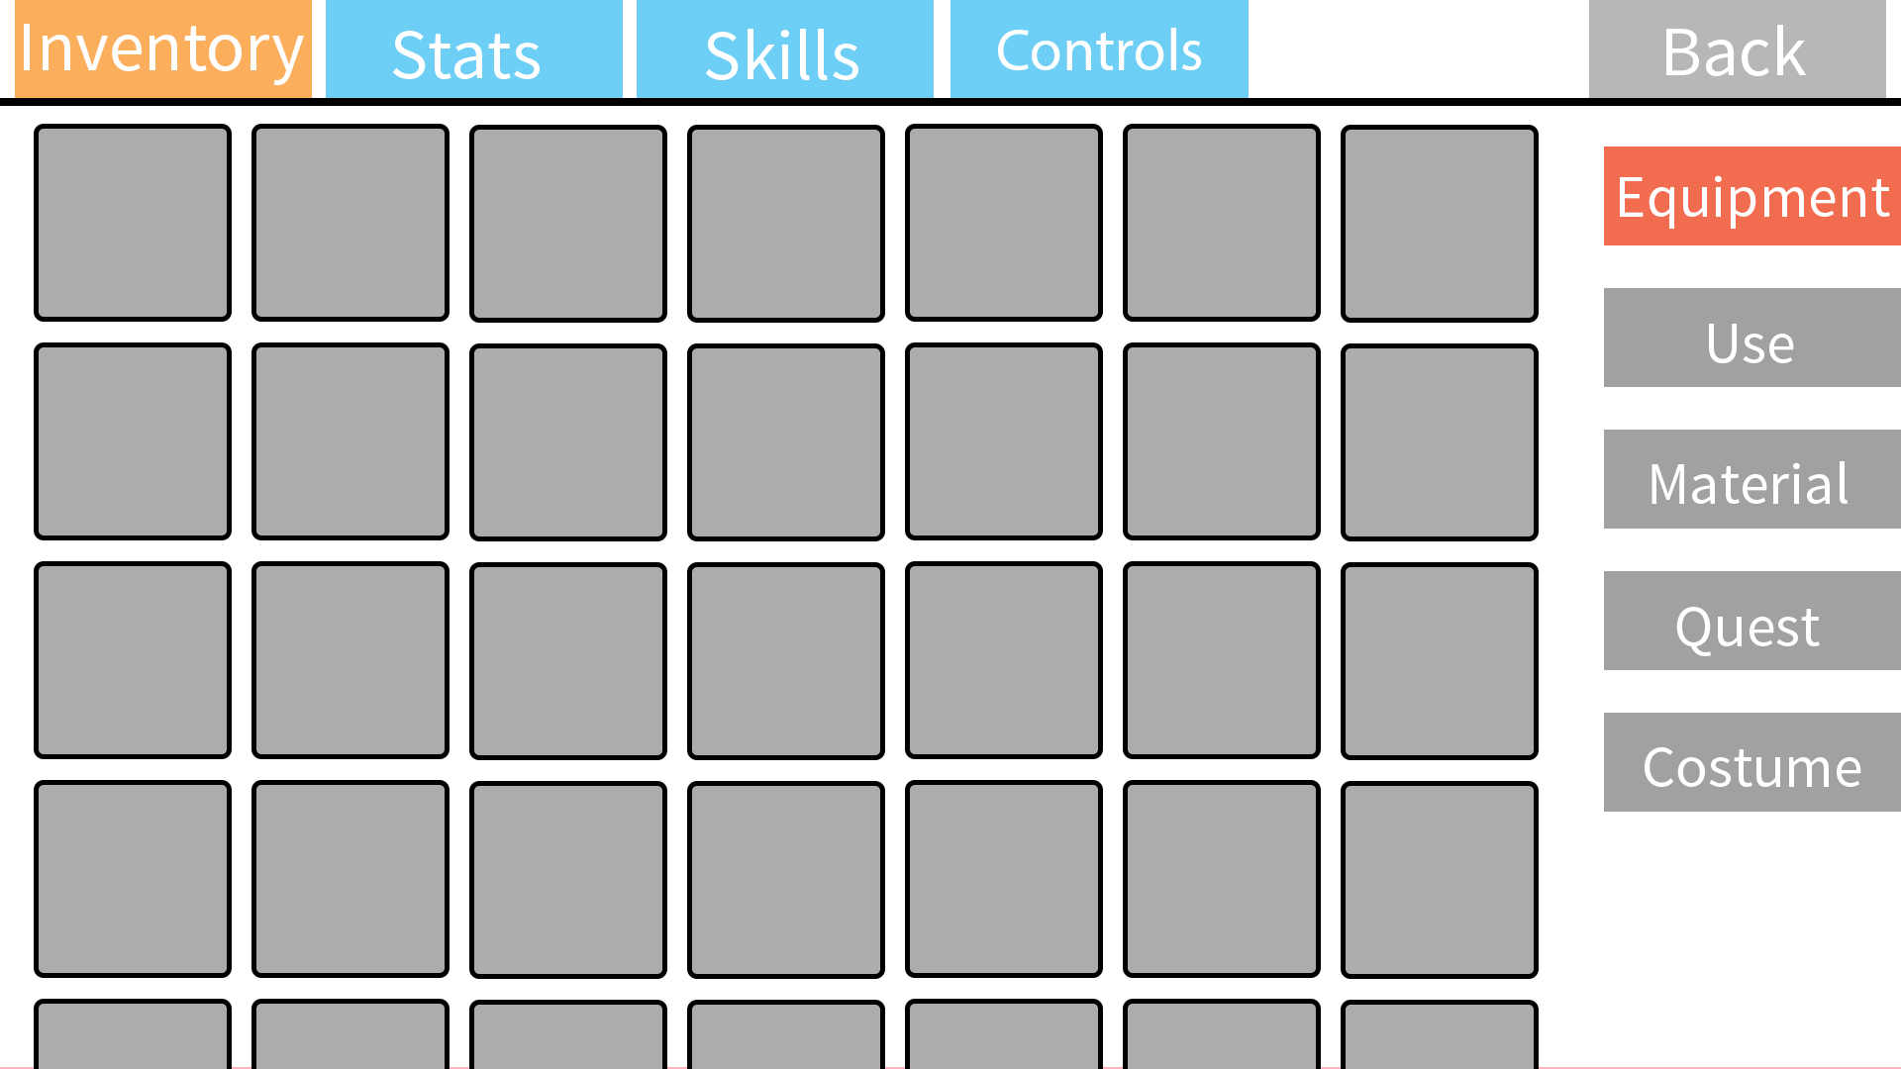
Gold
1,000,000,000

Slide 14
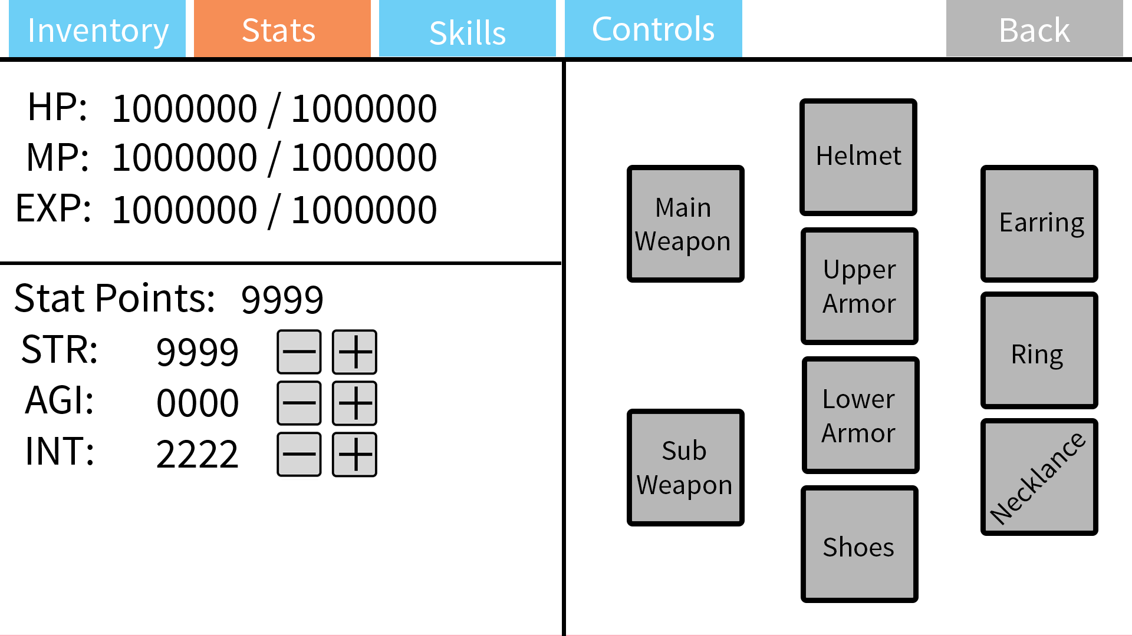

Slide 15
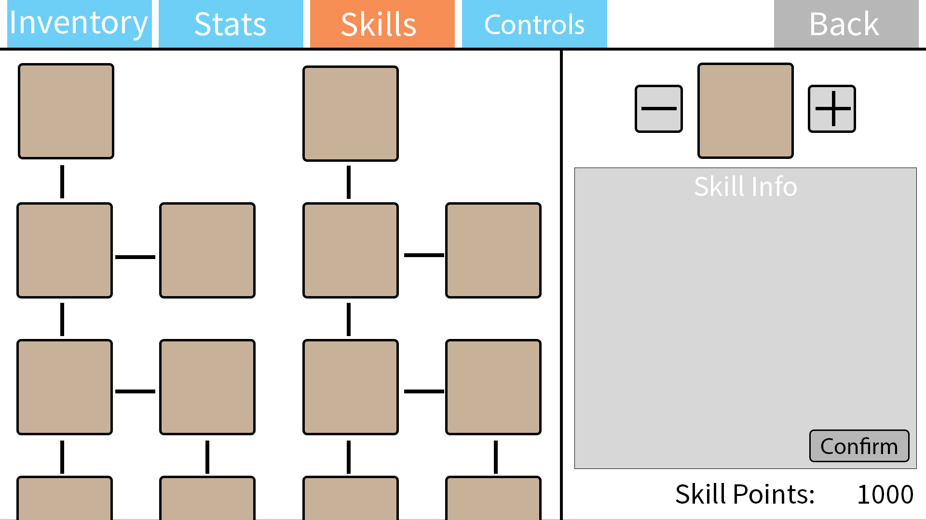

Slide 16
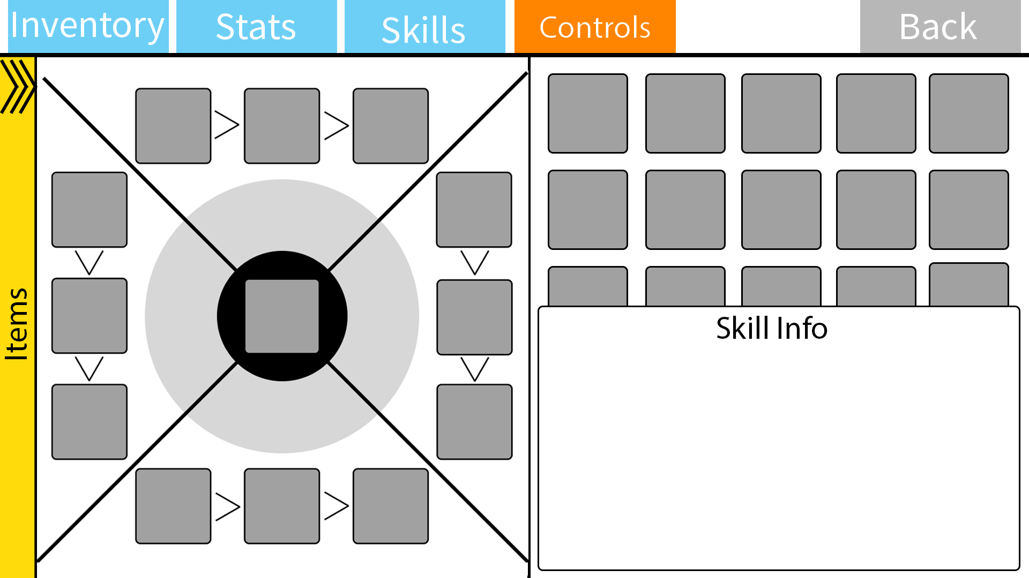

Slide 17
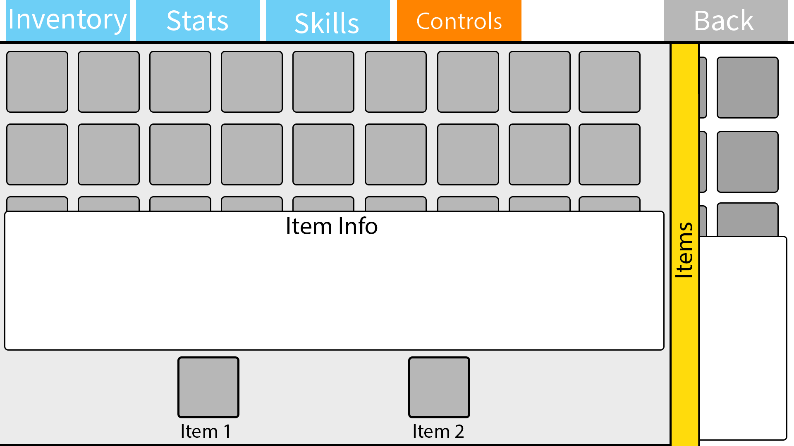

Slide 18
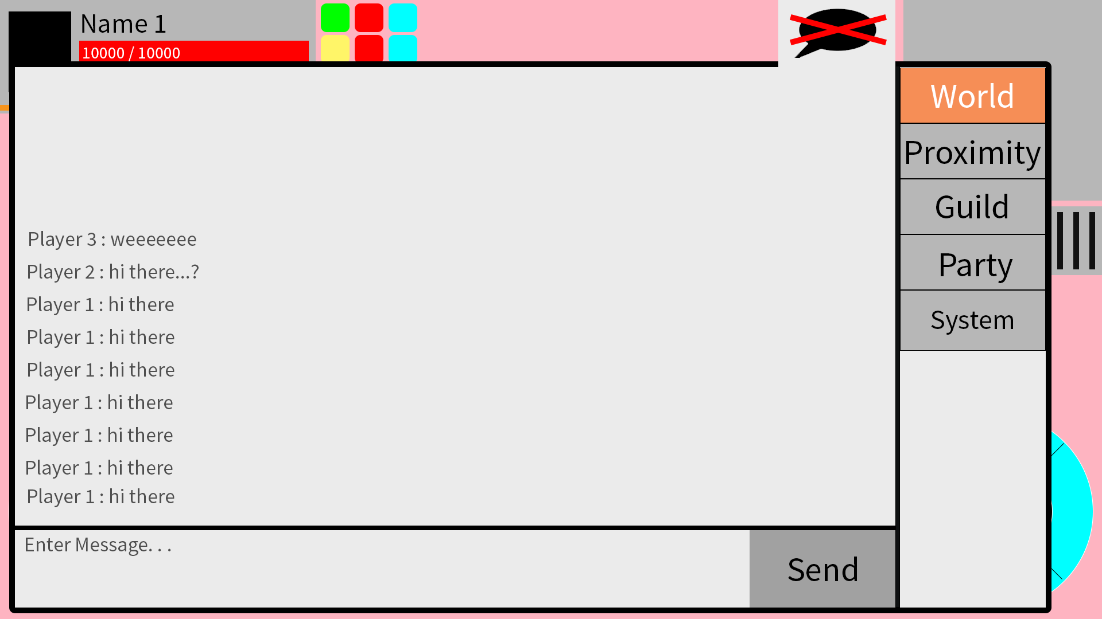

Slide 19
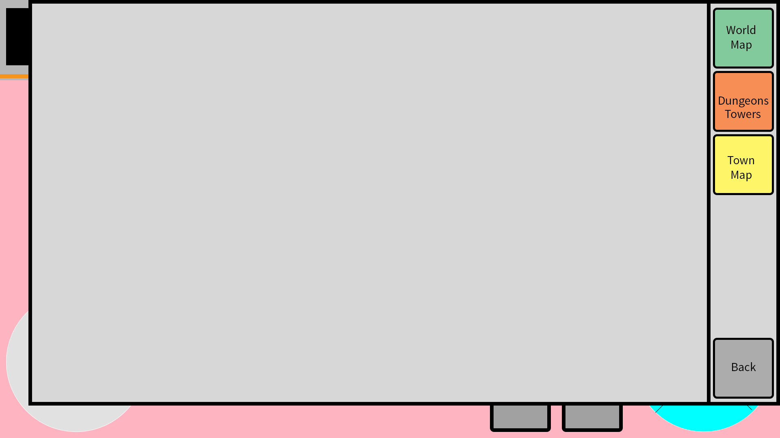

Slide 20
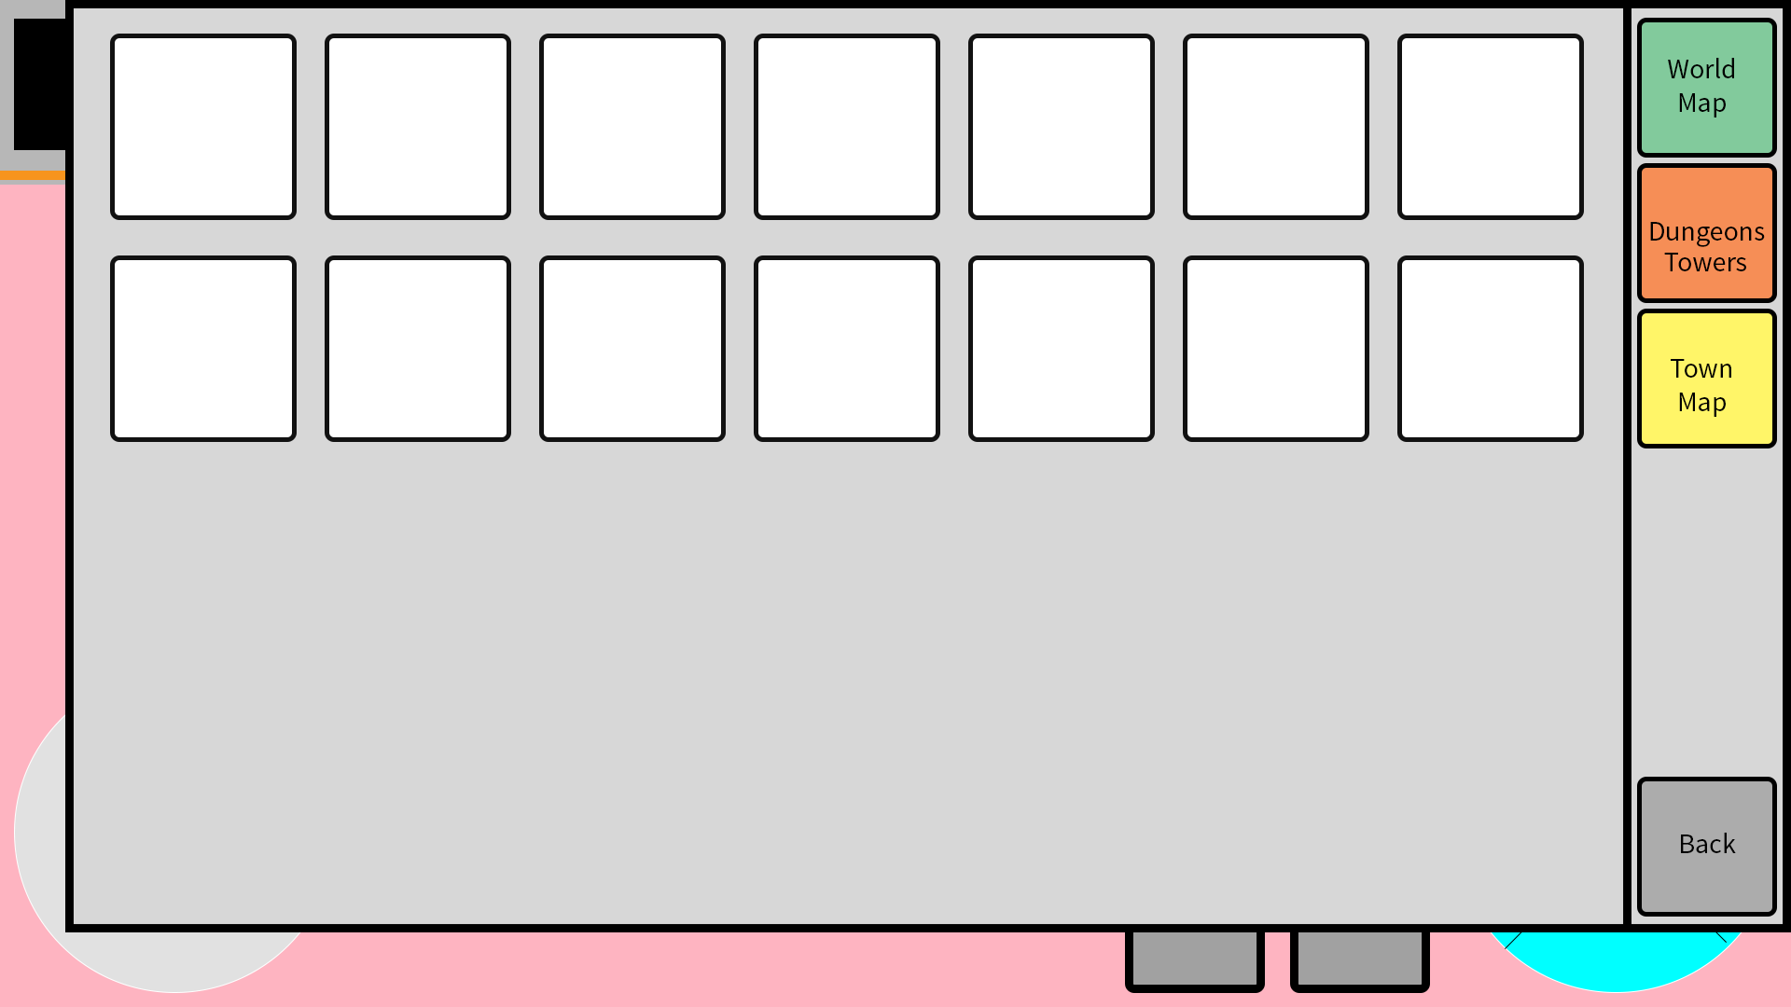

Slide 21
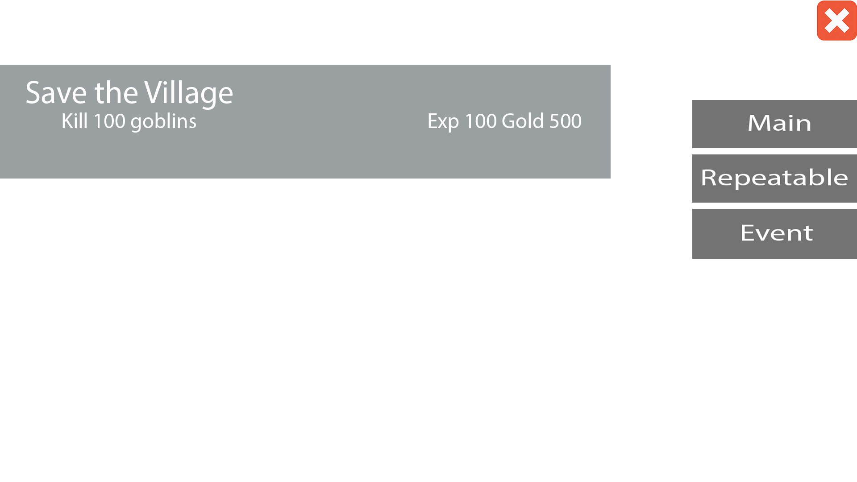

Slide 22
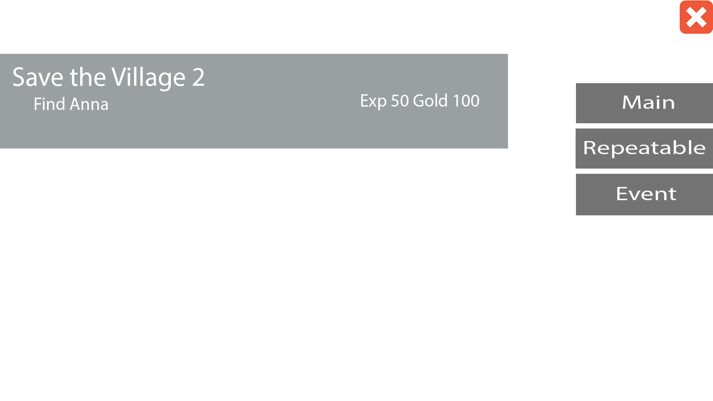

Slide 23
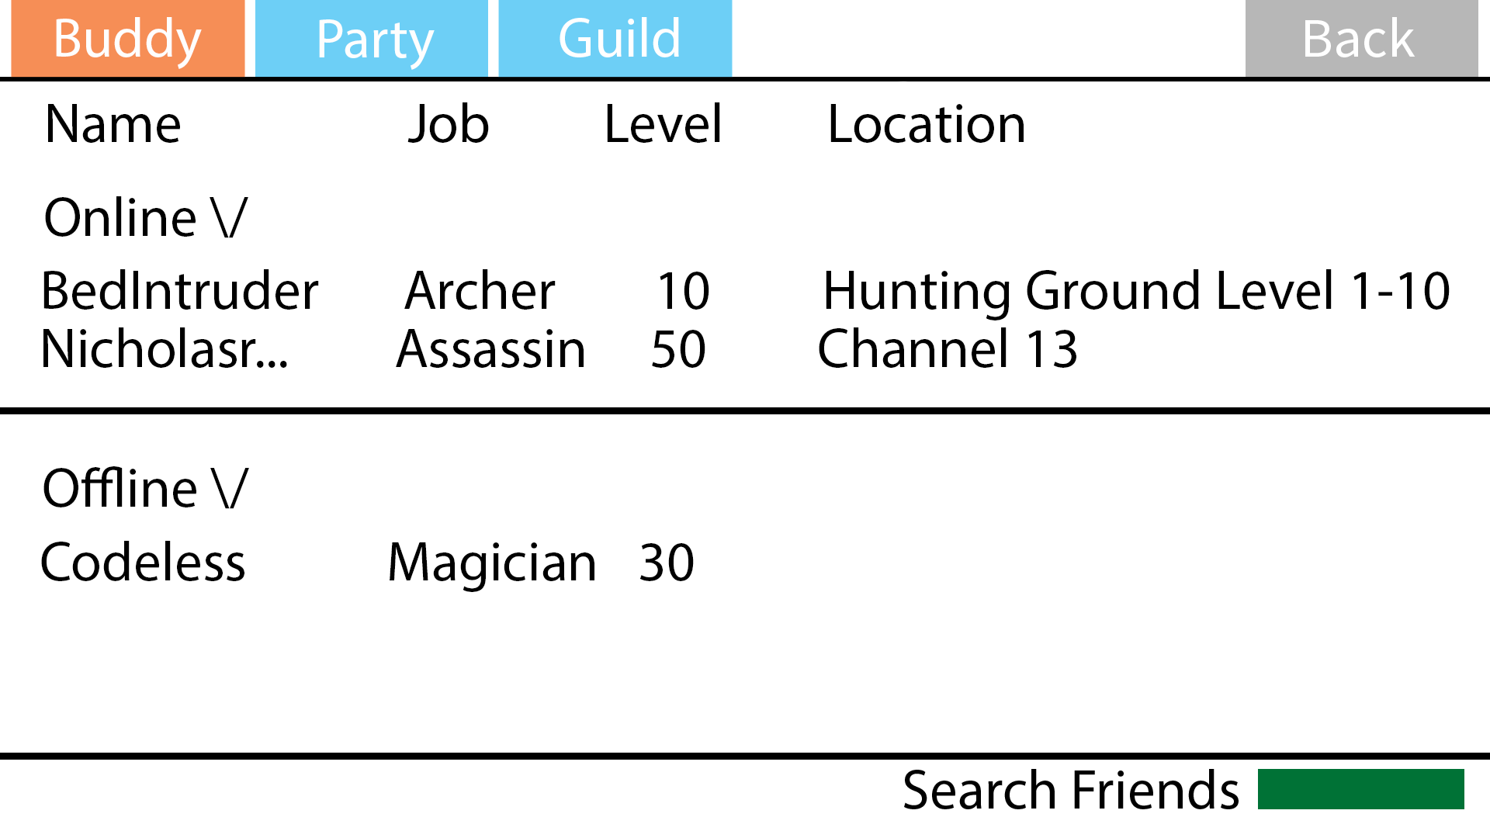

Slide 24
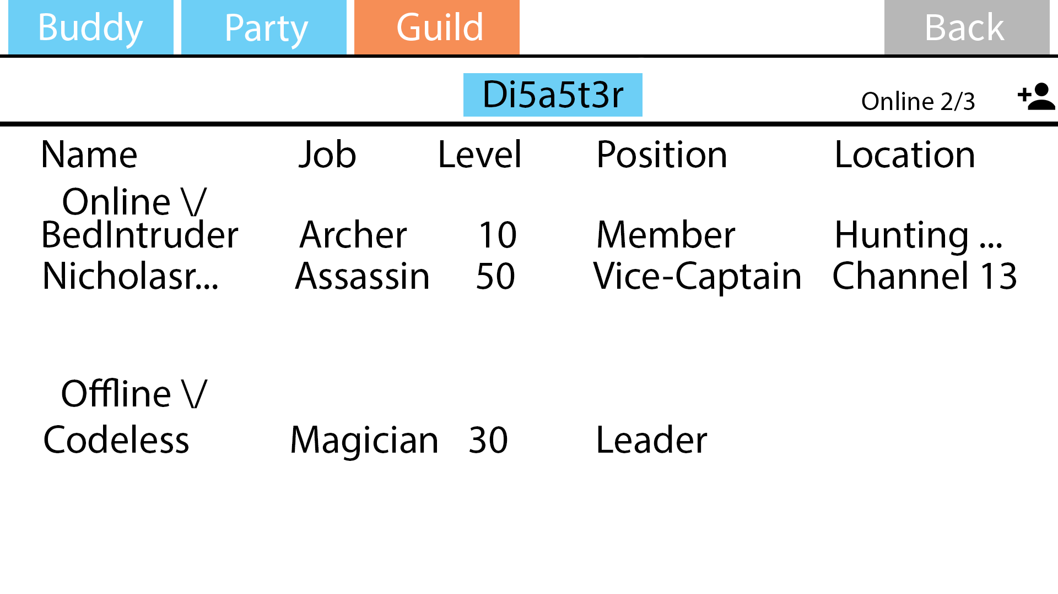

Slide 25
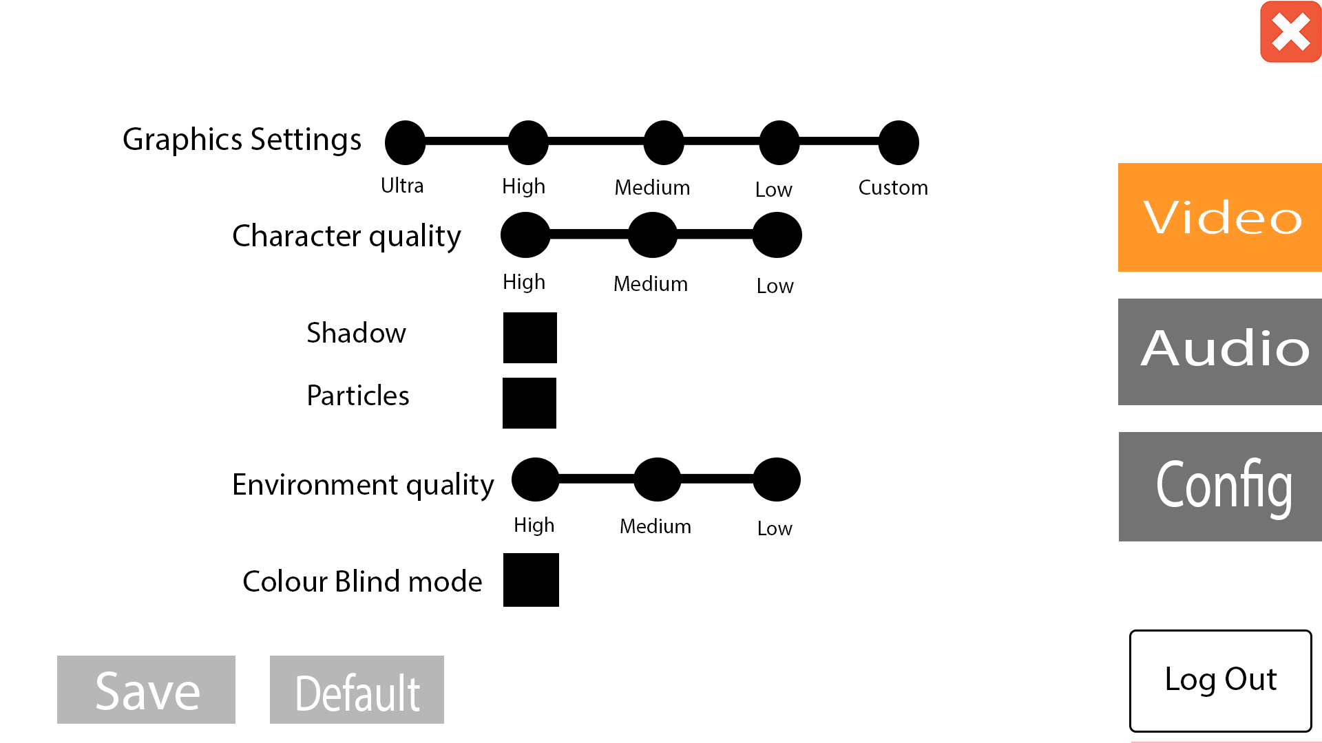

Slide 26
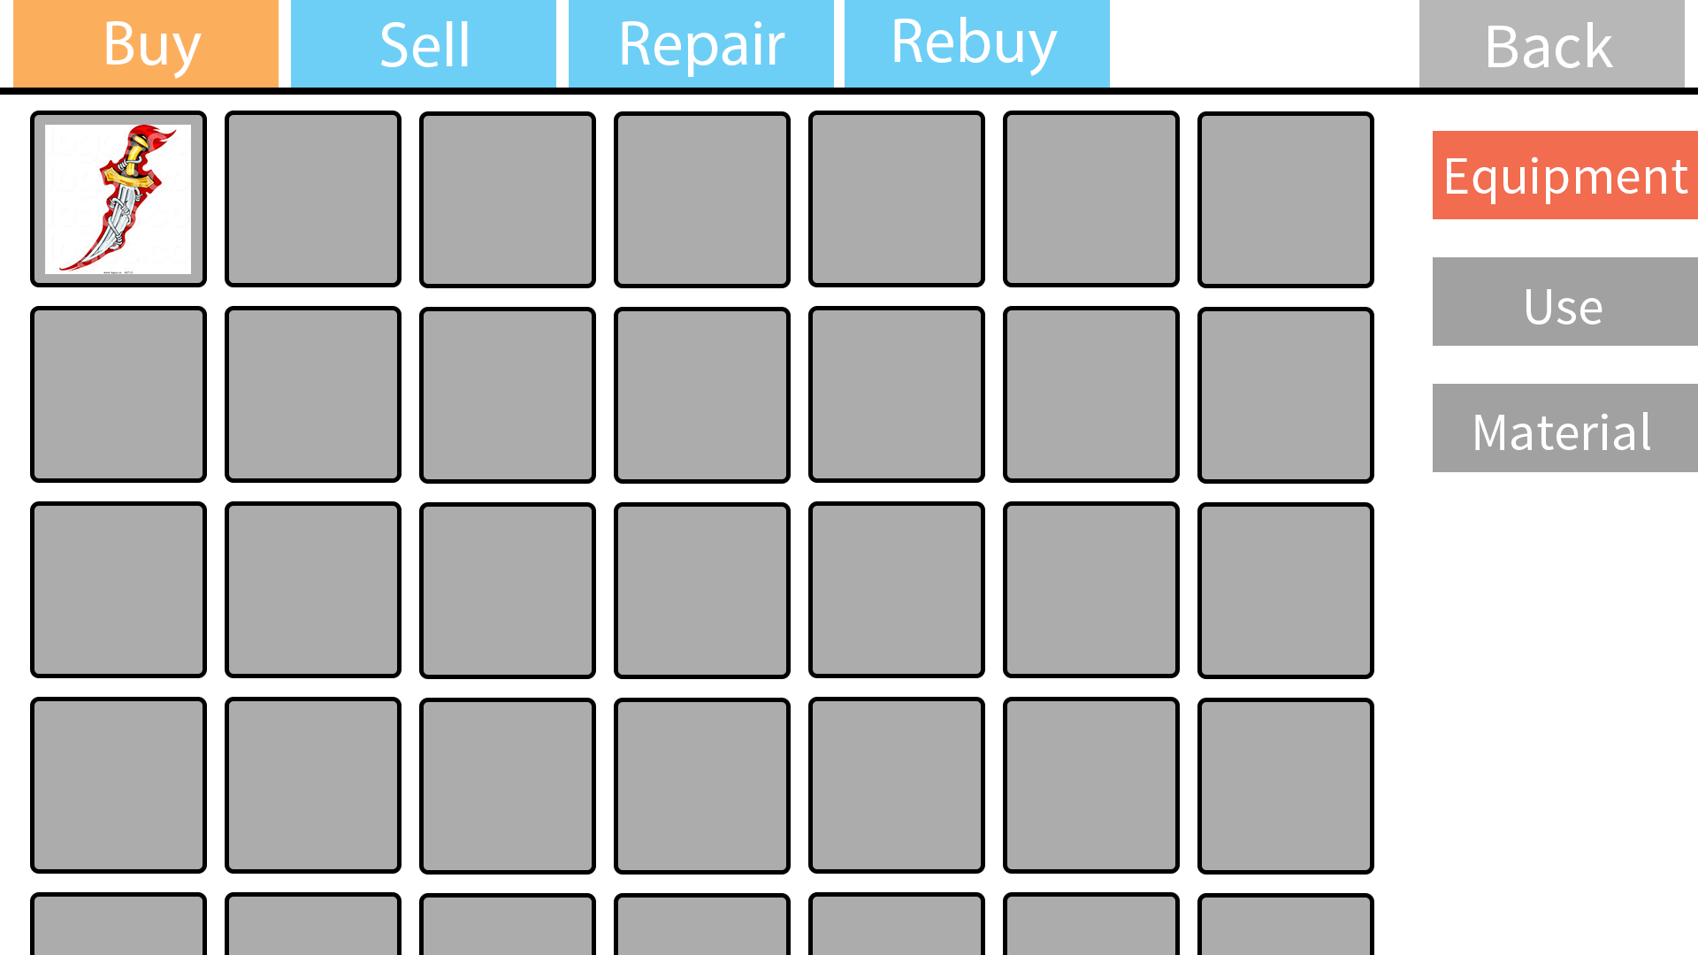

Slide 27
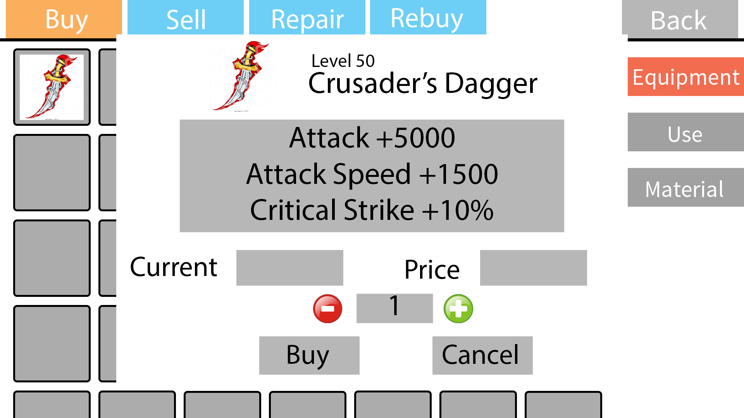

Slide 28
